Slide 1
"Digital Media Primer" Yue-Ling Wong,
Copyright (c)2013 by Pearson Education, Inc. All rights reserved.

Slide 2
Chapter 4
Fundamentals of Digital Audio
Part 1
The Nature of Sound Wave

Slide 3
In this lecture, you will learn:
What a waveform is
How waveforms represent sound waves
Relationship between sound frequency and sound pitch
How to read decibels

Slide 4
Sound
A wave that is generated by vibrating objects in a medium such as air
Examples of vibrating objects:
  vocal cords of a person
  guitar strings
  tuning fork

Slide 5

So how is vibration turned into sound we can hear or record with a microphone?
?
?
Recorded Sound

Slide 6
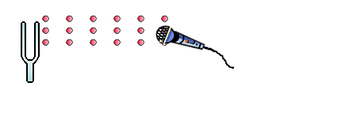
An illustration of how the propagating sound wave formed by changes of the air pressure reaches the microphone
tunning fork
air molecules
microphone

Slide 7
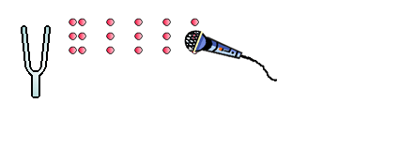
An illustration of how the propagating sound wave formed by changes of the air pressure reaches the microphone

Slide 8
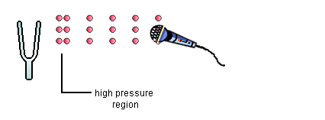
Let's step through the process slowly

Slide 9
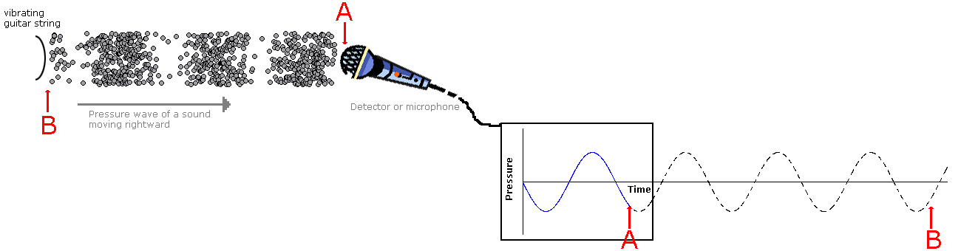
The changes of pressure in the propagating sound wave reaching the recorder are captured as changes of electrical signals over time.

Slide 10
The sound wave can be represented graphically with the changes in air pressure or electrical signals plotted over time—a waveform.

Slide 11
Be careful...
NOT to interpret sound as a wave that has crests and troughs
NOT to interpret the waveform as a representation of the sound wave in space
  i.e. air molecules are not going up and down

Slide 12


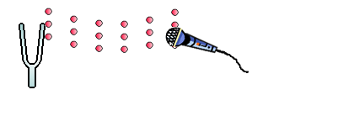

Slide 13

An illustration of sound wave as longitudinal air-pressure wave.
Also see the interactive tutorial:
SOUND AS A PRESSURE WAVE

Slide 14
Frequency of Sound Wave
Refers to the number of complete back-and-forth cycles of vibrational motion of the medium particles per unit of time
Unit for frequency: Hz (Hertz)
1 Hz = 1 cycle/second

Slide 15
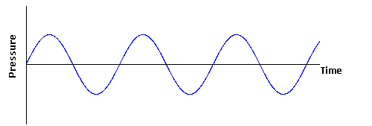
A Cycle
a cycle
a cycle
a cycle
a cycle

Slide 16
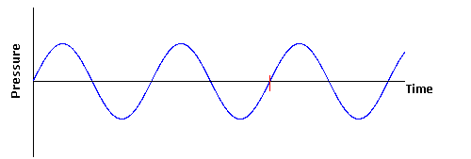
Frequency
Suppose it is1 second
a cycle
a cycle
Frequency = 2 Hz (i.e., 2 cycles/second)

Slide 17
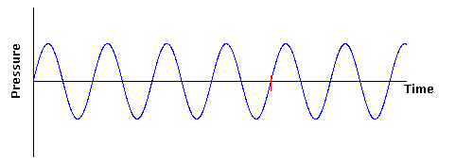
Frequency
Suppose it is1 second
a cycle
a cycle
a cycle
a cycle
Frequency = 4 Hz (i.e., 4 cycles/second)
Higher frequency than the previous waveform.

Slide 18
Pitch of Sound
Sound frequency
Higher frequency: higher pitch
human ear can hear sound ranging from 20 Hz to 20,000 Hz

Slide 19
Sound Intensity vs. Loudness
Sound intensity:
  an objective measurement
  can be measured with auditory devices
  in decibels (dB)
Loudness:
  a subjective perception
  measured by human listeners
  human ears have different sensitivity to different sound frequency
  in general, higher sound intensity means louder sound

Slide 20
Application of Decibels
Many audio-editing programs use decibels for the audio amplitude
3 decibels: doubling the sound intensity
6 decibels: doubling the electrical voltages corresponding to the sound
Let's see why 3 and 6 decibels.

Slide 21
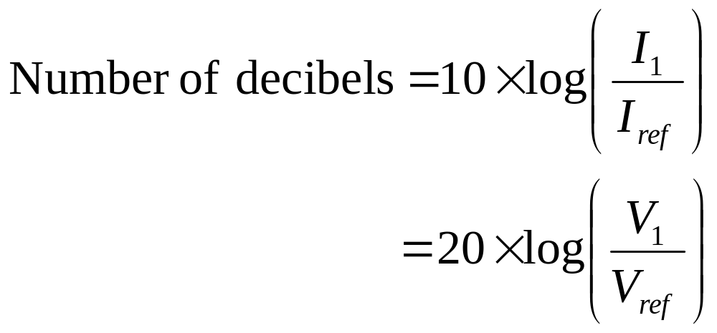
Decibels
I₁ and I_{ref} = sound intensity values in comparison
V₁ and V_{ref} = corresponding electrical voltages

Slide 22
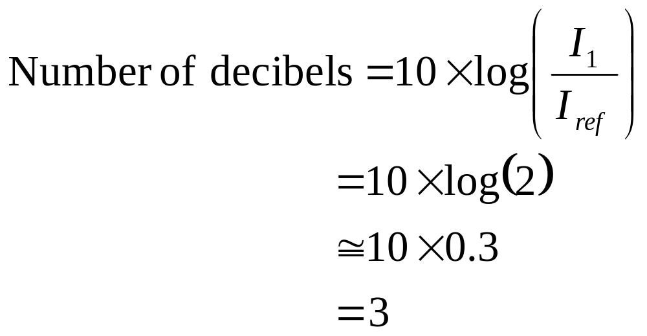
Decibels when doubling the sound intensity

Slide 23
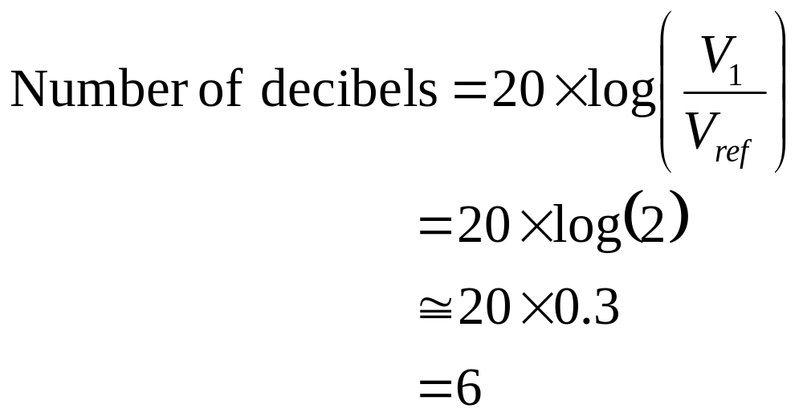
Decibels when doubling the electrical voltages

Slide 24
Decibels
Note the ratio of intensities or voltages in the equation
Number of decibels is not an absolute measurement but in comparison to a reference (I_{ref} or V_{ref})

Slide 25
Decibels
0 dB:
  Threshold of hearing
  minimum sound pressure level at which humans can hear a sound at a given frequency
  does NOT mean zero sound intensity
  does NOT mean absence of sound wave
about 120 dB:
  threshold of pain
  sound intensity that is 10¹² times greater than 0 dB

Slide 26
A Simple Sine Wave Waveform
A sinlge sine wave waveform
A single tone

Slide 27
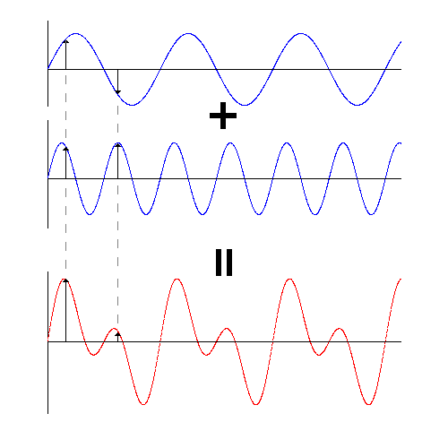
Adding Sound Waves
A single sine wave waveform
A single tone
A second single sine wave waveform
A second single tone
A more complex waveform
A more complex sound

Slide 28
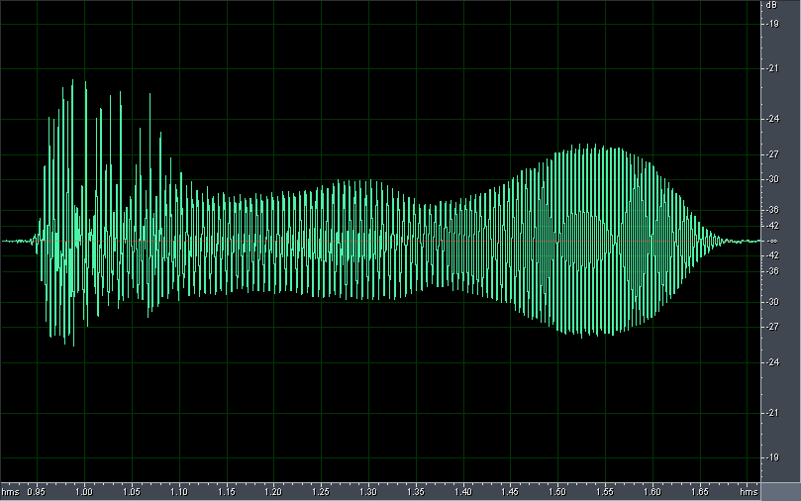
Waveform Example
A waveform of the spoken word "one"

Slide 29
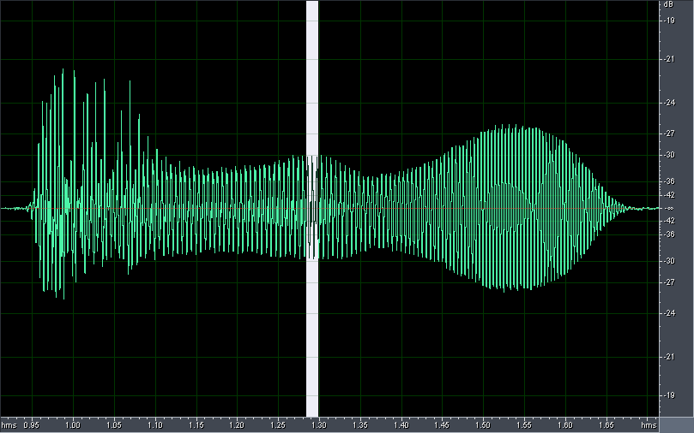
Waveform Example
Let's zoom in to take a closer look

Slide 30
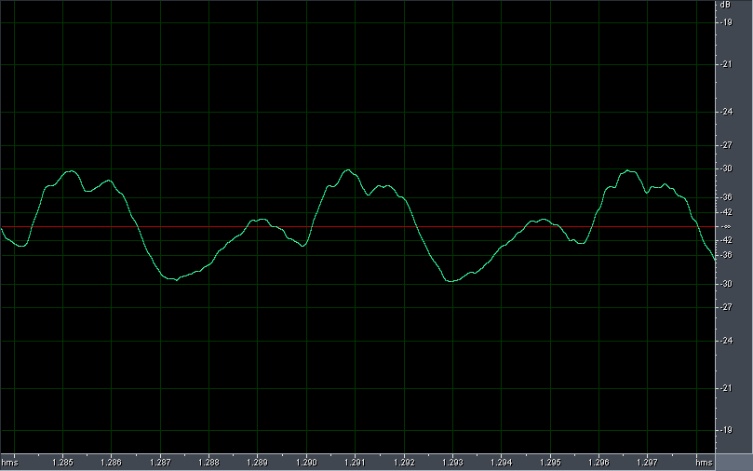
Waveform Example
A closer look

Slide 31
Review Questions
Note to instructor:
Depending on your preference, you may want to go over the review questions at the end of this lecture as an instant review or at the beginning of next lecture to refresh students' memory of this lecture.

Slide 32
Review Question
Which of the following gives a correct illustration of the sound wave propagation?
Both are correct; it depends on the type of sound.
Notes:
B

Slide 33
Review Question
A sound with higher ___ is perceived to have a higher pitch.
decibels
frequency
fidelity
sampling rate
bit depth
Notes:
B

Slide 34
Review Question
The unit used for measuing ___ is Hertz (Hz).
amplitude
frequency
dynamic range
sampling rate
bit depth
Notes:
B and D

Slide 35
Review Question
A waveform is a graphical representation of the ___ fluctuations of a sound wave.
pressure-time
space-time
pressure-space
Notes:
A

Slide 36
Review Question
The horizontal axis of a waveform is ___.
pressure
distance
time
Notes:
C

Slide 37
Review Question
The vertical axis of a waveform is ___.
pressure
distance
time
Notes:
A

Slide 38
Review Question
True/False: Zero decibel is when there is absence of sound or no sound wave.
Notes:
False

Slide 39
Review Question
The ___ of a sound relates to the sound intensity or loudness.
amplitude
frequency
sampling rate
bit depth
dynamic range
Notes:
B and D

